Slide 1
Mechanics
Further Kinematics
Twitter: @Owen134866
www.mathsfreeresourcelibrary.com

Slide 2




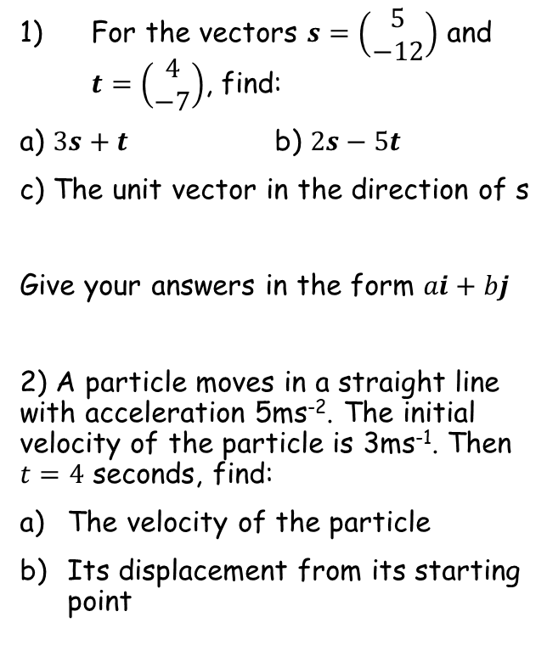






Prior knowledge check
For the vectors $s=\left(\begin{matrix}5 \\ −12\end{matrix}\right)$ and $t=\left(\begin{matrix}4 \\ −7\end{matrix}\right)$, find:
a) $3s+t$ b) $2s−5t$
c) The unit vector in the direction of s
Give your answers in the form $ai+bj$
2) A particle moves in a straight line with acceleration 5ms⁻². The initial velocity of the particle is 3ms⁻¹. Then $t=4$ seconds, find:
The velocity of the particle
Its displacement from its starting point
3a) Differentiate the following:
i) ${3e}^{2x}$ ii) $2sin3x$
b) Integrate the following:
i) ${4e}^{3x+1}$ ii) $5cos2πx$
$${6e}^{2x}$$
$$6cos3x$$
$$19i−43j$$
$$−10i+11j$$
$$\frac{5}{13}i−\frac{12}{13}j$$
$${\frac{4}{3}e}^{3x+1}$$
$$\frac{5}{2π}sin2πx$$
$$23{ms}^{−1}$$
$$52m$$

Slide 3
Teachings for
Exercise 8A

Slide 4

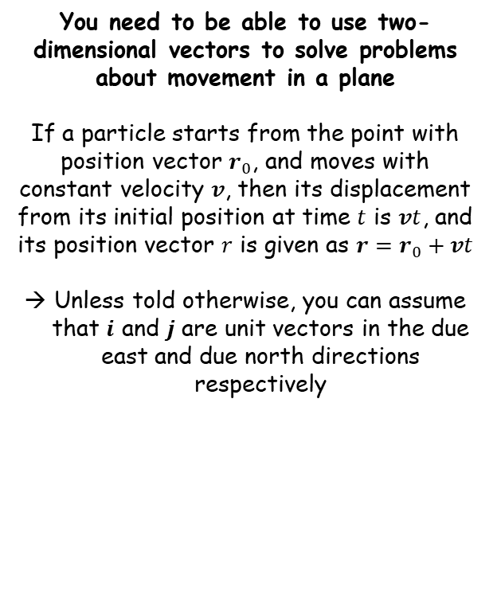


Further Kinematics
$$r=r_{0}+vt$$
You need to be able to use two-dimensional vectors to solve problems about movement in a plane
If a particle starts from the point with position vector $r_{0}$, and moves with constant velocity $v$, then its displacement from its initial position at time $t$ is $vt$, and its position vector $r$ is given as $r=r_{0}+vt$
Unless told otherwise, you can assume that $i$ and $j$ are unit vectors in the due east and due north directions respectively
Time
$$r=r_{0}+vt$$
Position at time $t$
Original position
Velocity
8A

Slide 5



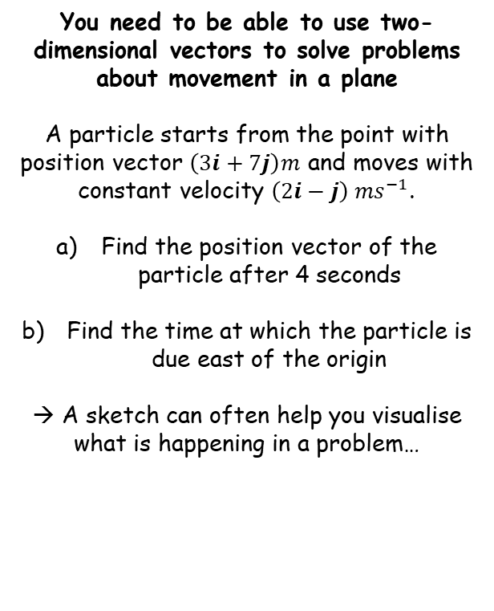






Further Kinematics
$$r=r_{0}+vt$$
North ($j$)
You need to be able to use two-dimensional vectors to solve problems about movement in a plane
A particle starts from the point with position vector $\left(3i+7j\right)m$ and moves with constant velocity $\left(2i−j\right) {ms}^{−1}$.
Find the position vector of the particle after 4 seconds
Find the time at which the particle is due east of the origin
→ A sketch can often help you visualise what is happening in a problem…
$$r_{0}=(3i+7j)$$
$$v=(2i−j)$$
East ($i$)
$$r=\left(11i+3j\right) m$$
Position after 4 seconds
$$r=r_{0}+vt$$
Sub in values
$$r=(3i+7j)+\left(2i−j\right)(4)$$
Expand bracket
$$r=3i+7j+8i−4j$$
Simplify
$$r=11i+3j$$
8A

Slide 6


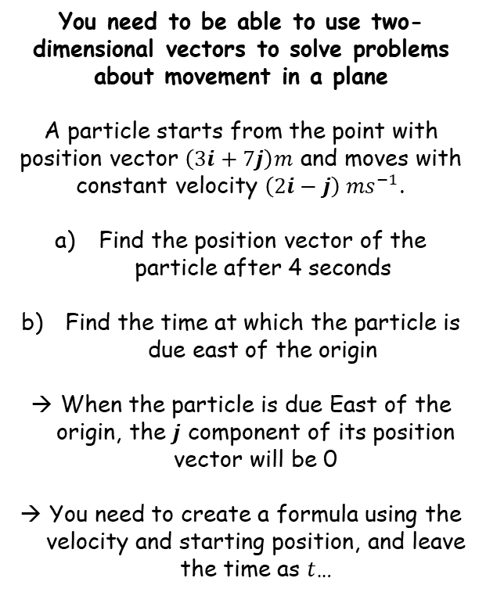




Further Kinematics
$$r=r_{0}+vt$$
North ($j$)
You need to be able to use two-dimensional vectors to solve problems about movement in a plane
A particle starts from the point with position vector $\left(3i+7j\right)m$ and moves with constant velocity $\left(2i−j\right) {ms}^{−1}$.
Find the position vector of the particle after 4 seconds
Find the time at which the particle is due east of the origin
When the particle is due East of the origin, the $j$ component of its position vector will be 0
You need to create a formula using the velocity and starting position, and leave the time as $t$…
$$r_{0}=(3i+7j)$$
$$v=(2i−j)$$
East ($i$)
$$r=\left(11i+3j\right) m$$
$$r=r_{0}+vt$$
Sub in values. This means $r$ is the position of the particle at time $t$
$$r=(3i+7j)+\left(2i−j\right)t$$
Expand brackets
$$r=3i+7j+2ti−tj$$
Refactorise the $i$ and $j$ components separately
$$r=(3+2t)i+(7−t)j$$
The $j$ component will be 0, therefore $t=7$
8A

Slide 7




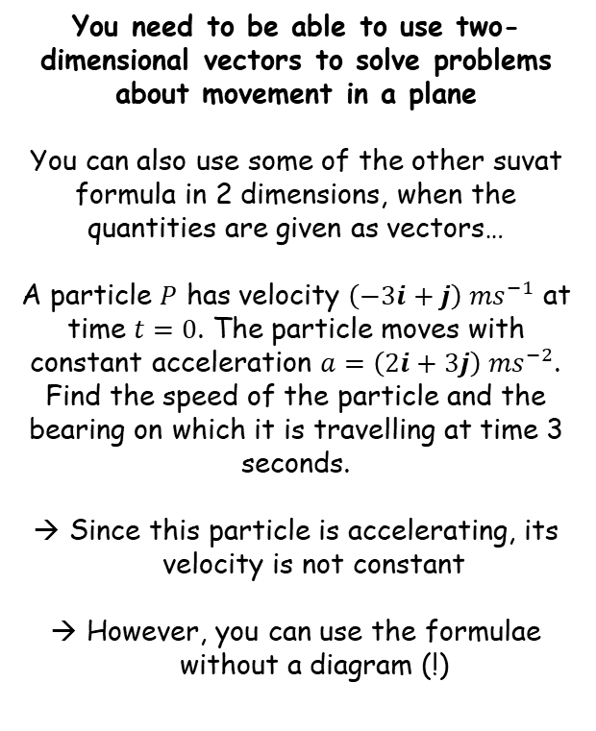






Further Kinematics
$$r=r_{0}+vt$$
$$v=u+at$$
$$r=ut+\frac{1}{2}at^{2}$$
You need to be able to use two-dimensional vectors to solve problems about movement in a plane
You can also use some of the other suvat formula in 2 dimensions, when the quantities are given as vectors…
A particle $P$ has velocity $\left(−3i+j\right) {ms}^{−1}$ at time $t=0$. The particle moves with constant acceleration $a=\left(2i+3j\right) {ms}^{−2}$. Find the speed of the particle and the bearing on which it is travelling at time 3 seconds.
Since this particle is accelerating, its velocity is not constant
However, you can use the formulae without a diagram (!)
Finding the speed after 3 seconds
$$v=u+at$$
Sub in values
$$v=\left(−3i+j\right)+\left(2i+3j\right)(3)$$
Simplify
$$v=\left(3i+10j\right) {ms}^{−1}$$
→ Remember that the speed is the magnitude of the velocity…
$$3i+10j$$
$$10j$$
$$3i$$
$$Speed=\sqrt{{(3)}^{2}+{(10)}^{2}}$$
Calculate
$$=10.4 {ms}^{−1}$$
8A

Slide 8












Further Kinematics
$$r=r_{0}+vt$$
$$v=u+at$$
$$r=ut+\frac{1}{2}at^{2}$$
You need to be able to use two-dimensional vectors to solve problems about movement in a plane
You can also use some of the other suvat formula in 2 dimensions, when the quantities are given as vectors…
A particle $P$ has velocity $\left(−3i+j\right) {ms}^{−1}$ at time $t=0$. The particle moves with constant acceleration $a=\left(2i+3j\right) {ms}^{−2}$. Find the speed of the particle and the bearing on which it is travelling at time 3 seconds.
Since this particle is accelerating, its velocity is not constant
However, you can use the formulae without a diagram (!)
Finding the bearing after 3 seconds
The bearing is the angle on which the particle is travelling
It is always measured clockwise from due north..
We can find it using the triangle we drew previously, using alternate angles…
$$3i+10j$$
$$N$$
$$θ$$
$$16.7^{°}$$
$$10j$$
$$16.7^{°}$$
$$θ$$
$$3i$$
$$θ={Tan}^{−1}\left(\frac{Opp}{Adj}\right)$$
Sub in values
$$θ={Tan}^{−1}\left(\frac{3}{10}\right)$$
Calculate
$$θ=16.7^{°}$$
Bearings are always given as 3 digit integers
$$Speed=10.4 {ms}^{−1}$$
$$Bearing={017}^{°}$$
8A

Slide 9



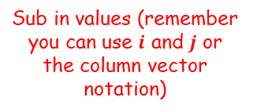
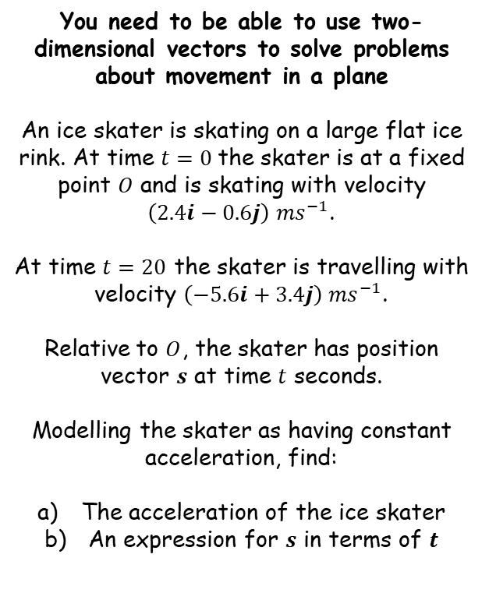




Further Kinematics
$$r=r_{0}+vt$$
$$v=u+at$$
$$r=ut+\frac{1}{2}at^{2}$$
You need to be able to use two-dimensional vectors to solve problems about movement in a plane
An ice skater is skating on a large flat ice rink. At time $t=0$the skater is at a fixed point $O$ and is skating with velocity $\left(2.4i−0.6j\right) {ms}^{−1}$.
At time $t=20$ the skater is travelling with velocity $\left(−5.6i+3.4j\right) {ms}^{−1}$.
Relative to $O$, the skater has position vector $s$ at time $t$ seconds.
Modelling the skater as having constant acceleration, find:
The acceleration of the ice skater
An expression for $s$ in terms of $t$
Finding the acceleration
$$v=u+at$$
Sub in values (remember you can use $i$ and $j$ or the column vector notation)
$$\left(\begin{matrix}−5.6 \\ 3.4\end{matrix}\right)=\left(\begin{matrix}2.4 \\ −0.6\end{matrix}\right)+20a$$
Rearrange
$$\left(\begin{matrix}−8 \\ 4\end{matrix}\right)=20a$$
Divide by 20
$$\left(\begin{matrix}−0.4 \\ 0.2\end{matrix}\right)=a$$
Write in $i$, $j$ form, (or you could leave it as it is!)
$$a=\left(−0.4i+0.2j\right)$$
$$a=\left(−0.4i+0.2j\right)$$
8A

Slide 10

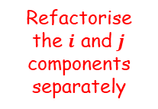

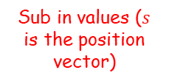



Further Kinematics
$$r=r_{0}+vt$$
$$v=u+at$$
$$r=ut+\frac{1}{2}at^{2}$$
You need to be able to use two-dimensional vectors to solve problems about movement in a plane
An ice skater is skating on a large flat ice rink. At time $t=0$the skater is at a fixed point $O$ and is skating with velocity $\left(2.4i−0.6j\right) {ms}^{−1}$.
At time $t=20$ the skater is travelling with velocity $\left(−5.6i+3.4j\right) {ms}^{−1}$.
Relative to $O$, the skater has position vector $s$ at time $t$ seconds.
Modelling the skater as having constant acceleration, find:
The acceleration of the ice skater
An expression for $s$ in terms of $t$
Finding an expression for $s$ in terms of $t$
$$r=ut+\frac{1}{2}at^{2}$$
Sub in values ($s$ is the position vector)
$$s=\left(2.4i−0.6j\right)t+\frac{1}{2}\left(−0.4i+0.2j\right)t^{2}$$
Multiply out brackets
$$s=2.4ti−0.6tj−0.2t^{2}i+0.1t^{2}j$$
Refactorise the $i$ and $j$ components separately
$$s=\left(2.4t−0.2t^{2}\right)i+\left(−0.6t+0.1t^{2}\right)j$$
$$a=\left(−0.4i+0.2j\right)$$
$$s=\left(2.4t−0.2t^{2}\right)i+\left(−0.6t+0.1t^{2}\right)j$$
8A

Slide 11



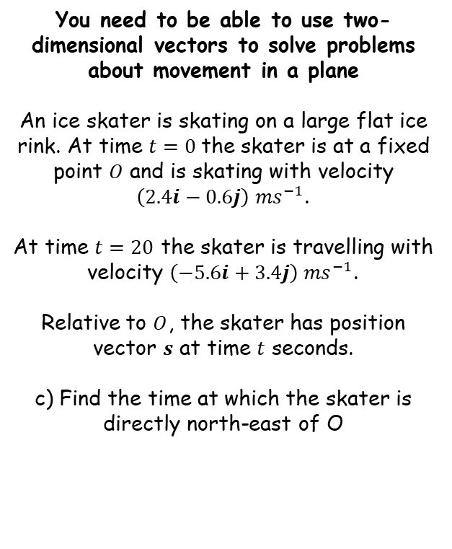





Further Kinematics
$$r=r_{0}+vt$$
$$v=u+at$$
$$r=ut+\frac{1}{2}at^{2}$$
You need to be able to use two-dimensional vectors to solve problems about movement in a plane
An ice skater is skating on a large flat ice rink. At time $t=0$the skater is at a fixed point $O$ and is skating with velocity $\left(2.4i−0.6j\right) {ms}^{−1}$.
At time $t=20$ the skater is travelling with velocity $\left(−5.6i+3.4j\right) {ms}^{−1}$.
Relative to $O$, the skater has position vector $s$ at time $t$ seconds.
c) Find the time at which the skater is directly north-east of O
$$a=\left(−0.4i+0.2j\right)$$
$$s=\left(2.4t−0.2t^{2}\right)i+\left(−0.6t+0.1t^{2}\right)j$$
→ When the skater is directly north east of $O$, the $i$ and $j$ components will be equal
North ($j$)
$$2.4t−0.2t^{2}=−0.6t+0.1t^{2}$$
Rearrange
$$3t−0.3t^{2}=0$$
Factorise
$$t(3−0.3t)=0$$
We need the value of $t$ when the bracket is 0 (since $t=0$ is when the skater starts)
$$3−0.3t=0$$
East ($i$)
Rearrange
$$3=0.3t$$
Divide by 0.3
$$10=t$$
8A

Slide 12
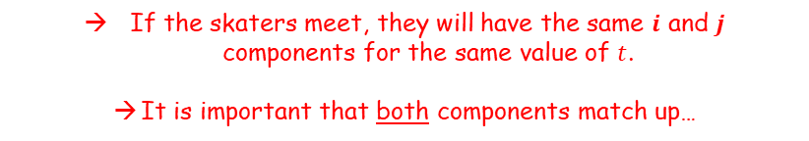



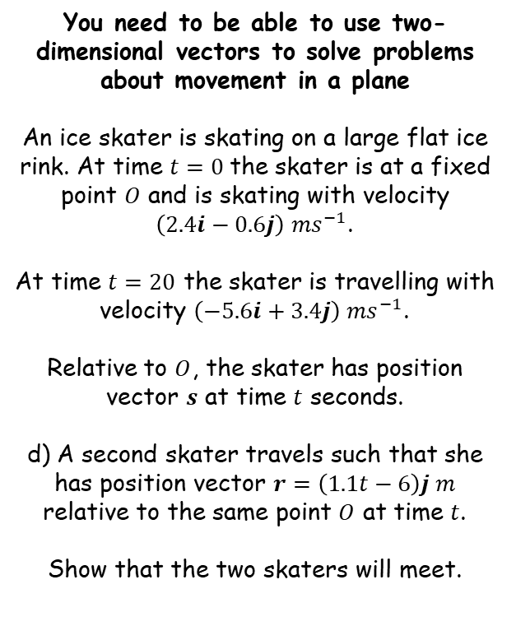






Further Kinematics
$$r=r_{0}+vt$$
$$v=u+at$$
$$r=ut+\frac{1}{2}at^{2}$$
The second skater’s $i$ component is always 0…
You need to be able to use two-dimensional vectors to solve problems about movement in a plane
An ice skater is skating on a large flat ice rink. At time $t=0$the skater is at a fixed point $O$ and is skating with velocity $\left(2.4i−0.6j\right) {ms}^{−1}$.
At time $t=20$ the skater is travelling with velocity $\left(−5.6i+3.4j\right) {ms}^{−1}$.
Relative to $O$, the skater has position vector $s$ at time $t$ seconds.
d) A second skater travels such that she has position vector $r=\left(1.1t−6\right)j m$ relative to the same point $O$ at time $t$.
Show that the two skaters will meet.
$$s=\left(2.4t−0.2t^{2}\right)i+\left(−0.6t+0.1t^{2}\right)j$$
$r=\left(1.1t−6\right)j$
If the skaters meet, they will have the same $i$ and $j$ components for the same value of $t$.
It is important that both components match up…
Comparing the $i$ components
$$2.4t−0.2t^{2}=0$$
Multiply by 5
$$12t−t^{2}=0$$
Factorise
$$t(12−t)=0$$
Solve
$$t=0 or 12$$
So the $i$ components will match when the time is either 0 or 12 seconds
$$t=0 or 12$$
8A

Slide 13

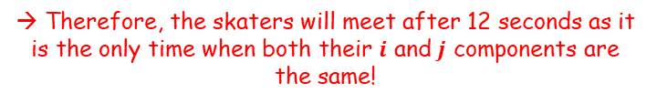






Further Kinematics
$$r=r_{0}+vt$$
$$v=u+at$$
$$r=ut+\frac{1}{2}at^{2}$$
You need to be able to use two-dimensional vectors to solve problems about movement in a plane
An ice skater is skating on a large flat ice rink. At time $t=0$the skater is at a fixed point $O$ and is skating with velocity $\left(2.4i−0.6j\right) {ms}^{−1}$.
At time $t=20$ the skater is travelling with velocity $\left(−5.6i+3.4j\right) {ms}^{−1}$.
Relative to $O$, the skater has position vector $s$ at time $t$ seconds.
d) A second skater travels such that she has position vector $r=\left(1.1t−6\right)j m$ relative to the same point $O$ at time $t$.
Show that the two skaters will meet.
$$s=\left(2.4t−0.2t^{2}\right)i+\left(−0.6t+0.1t^{2}\right)j$$
$r=\left(1.1t−6\right)j$
If the skaters meet, they will have the same $i$ and $j$ components for the same value of $t$.
It is important that both components match up…
Comparing the $j$ components
$$−0.6t+0.1t^{2}=1.1t−6$$
Rearrange
$$0.1t^{2}−1.7t+6=0$$
Multiply by 10
$$t^{2}−17t+60=0$$
Factorise
$$\left(t−12\right)\left(t−5\right)=0$$
Solve
$$t=5 or 12$$
So the $j$ components will match when the time is either 5 or 12 seconds
$$t=0 or 12$$
→ Therefore, the skaters will meet after 12 seconds as it is the only time when both their $i$ and $j$ components are the same!
8A

Slide 14
Teachings for
Exercise 8B

Slide 15



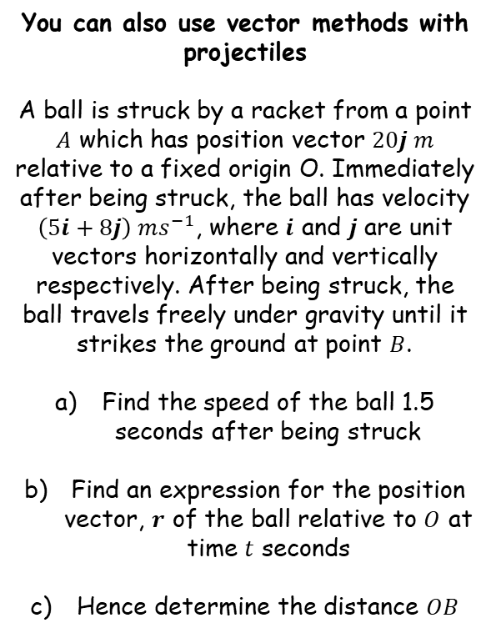
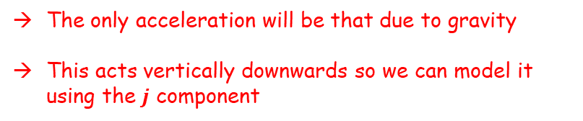





Further Kinematics
$$r=r_{0}+vt$$
$$v=u+at$$
$$r=ut+\frac{1}{2}at^{2}$$
$$\left(5i+8j\right) ms^{−1}$$
You can also use vector methods with projectiles
A ball is struck by a racket from a point $A$ which has position vector $20j m$ relative to a fixed origin O. Immediately after being struck, the ball has velocity $\left(5i+8j\right) ms^{−1}$, where $i$ and $j$ are unit vectors horizontally and vertically respectively. After being struck, the ball travels freely under gravity until it strikes the ground at point $B$.
Find the speed of the ball 1.5 seconds after being struck
Find an expression for the position vector, $r$ of the ball relative to $O$ at time $t$ seconds
Hence determine the distance $OB$
$$A$$
$$20j$$
O
$$B$$
The only acceleration will be that due to gravity
This acts vertically downwards so we can model it using the $j$ component
$$v=u+at$$
Sub in values, taking acceleration as $−9.8j$
$$v=\left(5i+8j\right)+(−9.8j)(1.5)$$
Calculate
$$v=\left(5i−6.7j\right) {ms}^{−1}$$
Remember that this is not the speed, it is the velocity…
8B

Slide 16





Further Kinematics
$$r=r_{0}+vt$$
$$v=u+at$$
$$r=ut+\frac{1}{2}at^{2}$$
$$\left(5i+8j\right) ms^{−1}$$
You can also use vector methods with projectiles
A ball is struck by a racket from a point $A$ which has position vector $20j m$ relative to a fixed origin O. Immediately after being struck, the ball has velocity $\left(5i+8j\right) ms^{−1}$, where $i$ and $j$ are unit vectors horizontally and vertically respectively. After being struck, the ball travels freely under gravity until it strikes the ground at point $B$.
Find the speed of the ball 1.5 seconds after being struck
Find an expression for the position vector, $r$ of the ball relative to $O$ at time $t$ seconds
Hence determine the distance $OB$
$$A$$
$$20j$$
O
$$B$$
$$v=\left(5i−6.7j\right) {ms}^{−1}$$
$$5i$$
$$6.7j$$
$$Speed=\sqrt{{(5)}^{2}+{(6.7)}^{2}}$$
Calculate
$$=8.4 {ms}^{−1}$$
8B

Slide 17








Further Kinematics
$$r=r_{0}+vt$$
$$v=u+at$$
$$r=ut+\frac{1}{2}at^{2}$$
$$\left(5i+8j\right) ms^{−1}$$
You can also use vector methods with projectiles
A ball is struck by a racket from a point $A$ which has position vector $20j m$ relative to a fixed origin O. Immediately after being struck, the ball has velocity $\left(5i+8j\right) ms^{−1}$, where $i$ and $j$ are unit vectors horizontally and vertically respectively. After being struck, the ball travels freely under gravity until it strikes the ground at point $B$.
Find the speed of the ball 1.5 seconds after being struck
Find an expression for the position vector, $r$ of the ball relative to $O$ at time $t$ seconds
Hence determine the distance $OB$
$$A$$
$$20j$$
O
$$B$$
→ We cannot use the formula $r=r_{0}+vt$ since the velocity is not constant…
$$r=ut+\frac{1}{2}at^{2}$$
$$8.4 {ms}^{−1}$$
Sub in values
$$r=\left(5i+8j\right)t+\frac{1}{2}(−9.8j)t^{2}$$
Expand brackets
$$r=5ti+8tj−4.9jt^{2}$$
Refactorise the $i$ and $j$ components
$$r=5ti+(8t−4.9t^{2})j$$
Be careful! This is the position of the ball relative to point $A$ (the question asks for the position relative to point $O$)
8B

Slide 18





Further Kinematics
$$r=r_{0}+vt$$
$$v=u+at$$
$$r=ut+\frac{1}{2}at^{2}$$
$$\left(5i+8j\right) ms^{−1}$$
You can also use vector methods with projectiles
A ball is struck by a racket from a point $A$ which has position vector $20j m$ relative to a fixed origin O. Immediately after being struck, the ball has velocity $\left(5i+8j\right) ms^{−1}$, where $i$ and $j$ are unit vectors horizontally and vertically respectively. After being struck, the ball travels freely under gravity until it strikes the ground at point $B$.
Find the speed of the ball 1.5 seconds after being struck
Find an expression for the position vector, $r$ of the ball relative to $O$ at time $t$ seconds
Hence determine the distance $OB$
$$A$$
$$20j$$
O
$$B$$
$$r=5ti+(8t−4.9t^{2})j$$
Add on $20j$ so the vector will be relative to O rather than A…)
$$r=5ti+\left(8t−4.9t^{2}\right)j+20j$$
This can also be put into the second bracket…
$$8.4 {ms}^{−1}$$
$$r=5ti+\left(8t−4.9t^{2}+20\right)j$$
$$r=5ti+\left(8t−4.9t^{2}+20\right)j$$
8B

Slide 19









Further Kinematics
$$r=r_{0}+vt$$
$$v=u+at$$
$$r=ut+\frac{1}{2}at^{2}$$
$$\left(5i+8j\right) ms^{−1}$$
You can also use vector methods with projectiles
A ball is struck by a racket from a point $A$ which has position vector $20j m$ relative to a fixed origin O. Immediately after being struck, the ball has velocity $\left(5i+8j\right) ms^{−1}$, where $i$ and $j$ are unit vectors horizontally and vertically respectively. After being struck, the ball travels freely under gravity until it strikes the ground at point $B$.
Find the speed of the ball 1.5 seconds after being struck
Find an expression for the position vector, $r$ of the ball relative to $O$ at time $t$ seconds
Hence determine the distance $OB$
$$A$$
$$20j$$
O
$$B$$
At point $B$, the $j$ component is 0
Set this part of the expression from b) equal to 0…
$$8t−4.9t^{2}+20=0$$
Solve using the quadratic formula, with $a=−4.9$, $b=8$ and $c=20$
$$8.4 {ms}^{−1}$$
$$t=−1.362 or 2.995$$
We can then substitute the value of 2.995 into the $i$ component to see how far the particle has moved in that direction…
$$r=5ti+\left(8t−4.9t^{2}+20\right)j$$
$$5ti$$
Sub in 2.995
$$=5(2.995)i$$
So the distance $OB$ is 15m (2sf)
$$=14.975i$$
Calculate
8B

Slide 20
Further Kinematics
$$r=r_{0}+vt$$
$$v=u+at$$
$$r=ut+\frac{1}{2}at^{2}$$
You can also use vector methods with projectiles
→ A key advantage of using vectors is that they allow you to resolve in multiple directions at the same time!
8B

Slide 21
Teachings for
Exercise 8C

Slide 22



Further Kinematics
You need to be able to use calculus to solve problems involving variable acceleration in one dimension
Displacement ($s$)
The SUVAT equations can be used when acceleration is constant and a particle is moving in a straight line.
If the acceleration of a particle varies, you need to use Calculus
Differentiate
Integrate
Velocity ($v$)
Differentiate
Integrate
Acceleration ($a$)
Velocity is the rate of change of displacement with respect to time
→ Therefore, differentiating displacement gives velocity
Acceleration is the rate of change of velocity with respect to time
→ Therefore, differentiating velocity gives acceleration
In reverse, use integration!
8C

Slide 23
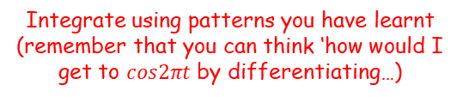


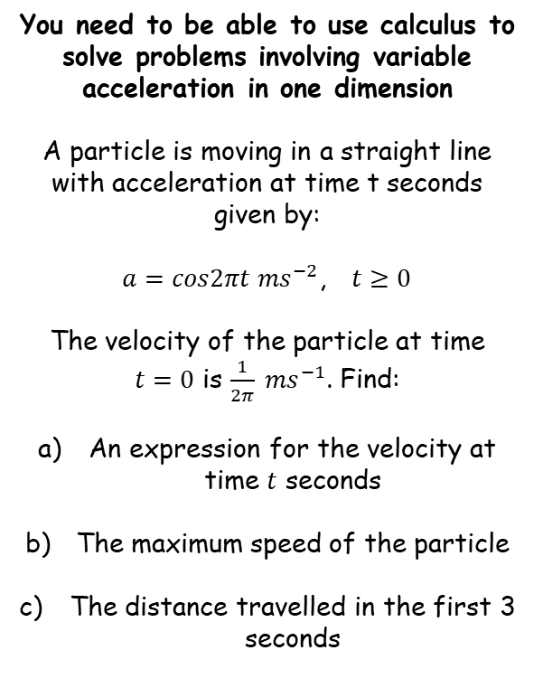





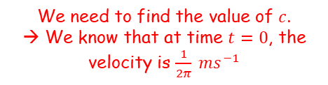
Further Kinematics
You need to be able to use calculus to solve problems involving variable acceleration in one dimension
A particle is moving in a straight line with acceleration at time t seconds given by:
$a=cos2πt {ms}^{−2}$, $t≥0$
The velocity of the particle at time $t=0$ is $\frac{1}{2π} {ms}^{−1}$. Find:
An expression for the velocity at time $t$ seconds
The maximum speed of the particle
The distance travelled in the first 3 seconds
→ You will need to use rules you have learnt in pure maths, with both differentiation and integration…
$$a=cos2πt$$
Integrate using patterns you have learnt (remember that you can think ‘how would I get to $cos2πt$ by differentiating…)
$$v=\frac{1}{2π}sin2πt+c$$
We need to find the value of $c$.
→ We know that at time $t=0$, the velocity is $\frac{1}{2π} {ms}^{−1}$
$$\frac{1}{2π}=\frac{1}{2π}sin2π(0)+c$$
Calculate
$$\frac{1}{2π}=c$$
We can now use the value of $c$ we found in the integral we found before…
$$v=\frac{1}{2π}sin2πt+\frac{1}{2π}$$
$$v=\frac{1}{2π}sin2πt+\frac{1}{2π}$$
8C

Slide 24






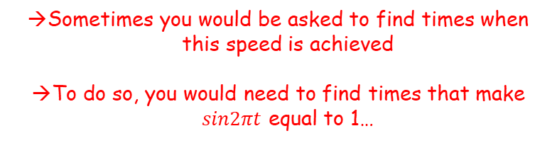
Further Kinematics
You need to be able to use calculus to solve problems involving variable acceleration in one dimension
A particle is moving in a straight line with acceleration at time t seconds given by:
$a=cos2πt {ms}^{−2}$, $t≥0$
The velocity of the particle at time $t=0$ is $\frac{1}{2π} {ms}^{−1}$. Find:
An expression for the velocity at time $t$ seconds
The maximum speed of the particle
The distance travelled in the first 3 seconds
$$v=\frac{1}{2π}sin2πt+\frac{1}{2π}$$
The maximum value of $sin2πt$ is 1…
$$v=\frac{1}{2π}(1)+\frac{1}{2π}$$
Add together
$$v=\frac{2}{2π}$$
Simplify
$$v=\frac{1}{π}$$
Sometimes you would be asked to find times when this speed is achieved
To do so, you would need to find times that make $sin2πt$ equal to 1…
$$v=\frac{1}{2π}sin2πt+\frac{1}{2π}$$
$$v=\frac{1}{π}$$
8C

Slide 25
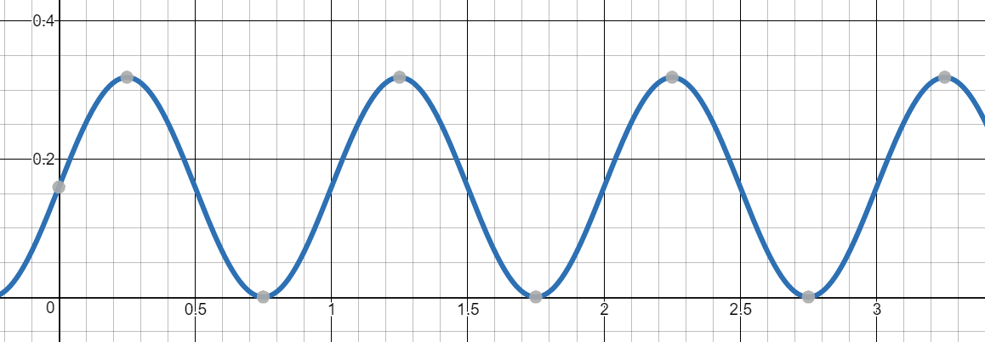


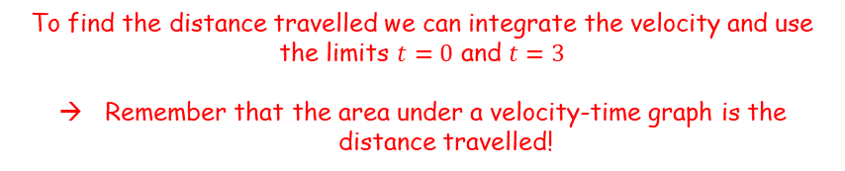

Further Kinematics
To find the distance travelled we can integrate the velocity and use the limits $t=0$ and $t=3$
Remember that the area under a velocity-time graph is the distance travelled!
You need to be able to use calculus to solve problems involving variable acceleration in one dimension
A particle is moving in a straight line with acceleration at time t seconds given by:
$a=cos2πt {ms}^{−2}$, $t≥0$
The velocity of the particle at time $t=0$ is $\frac{1}{2π} {ms}^{−1}$. Find:
An expression for the velocity at time $t$ seconds
The maximum speed of the particle
The distance travelled in the first 3 seconds
$$v=\frac{1}{2π}sin2πt+\frac{1}{2π}$$
$$t=0$$
$$t=3$$
You need to be careful with these questions. If part of the graph was below the x-axis, then you would need to split the regions up and find their values separately
This is because just integrating the velocity actually gives the displacement, not the distance
If the graph went below the x-axis, it means the velocity is negative, hence there is a change of direction of the particle
This would keep increasing the distance travelled, but would reduce its displacement…
$$v=\frac{1}{2π}sin2πt+\frac{1}{2π}$$
$$v=\frac{1}{π}$$
8C

Slide 26








Further Kinematics
You need to be able to use calculus to solve problems involving variable acceleration in one dimension
A particle is moving in a straight line with acceleration at time t seconds given by:
$a=cos2πt {ms}^{−2}$, $t≥0$
The velocity of the particle at time $t=0$ is $\frac{1}{2π} {ms}^{−1}$. Find:
An expression for the velocity at time $t$ seconds
The maximum speed of the particle
The distance travelled in the first 3 seconds
$$v=\frac{1}{2π}sin2πt+\frac{1}{2π}$$
Write the integral we need to do
$$s=\int_{0}^{3}{\left(\frac{1}{2π}sin2πt+\frac{1}{2π}\right) dt}$$
You can take out the $\frac{1}{2π}$ to make things a bit simpler
$$s=\frac{1}{2π}\int_{0}^{3}{\left(sin2πt+1\right) dt}$$
Integrate and use a square bracket
Sub in limits
$$=\frac{1}{2π}{\left[−\frac{1}{2π}cos2πt+t\right]}_{0}^{3}$$
$$=\frac{1}{2π}\left[\left(−\frac{1}{2π}cos2π\left(3\right)+(3)\right)−\left(−\frac{1}{2π}cos2π\left(0\right)+(0)\right)\right]$$
$$v=\frac{1}{2π}sin2πt+\frac{1}{2π}$$
$$=\frac{1}{2π}\left[\left(−\frac{1}{2π}+3\right)−\left(−\frac{1}{2π}\right)\right]$$
Calculate and round appropriately if needed…
Simplify
$$v=\frac{1}{π}$$
$$=\frac{3}{2π}m or 0.477m$$
8C

Slide 27



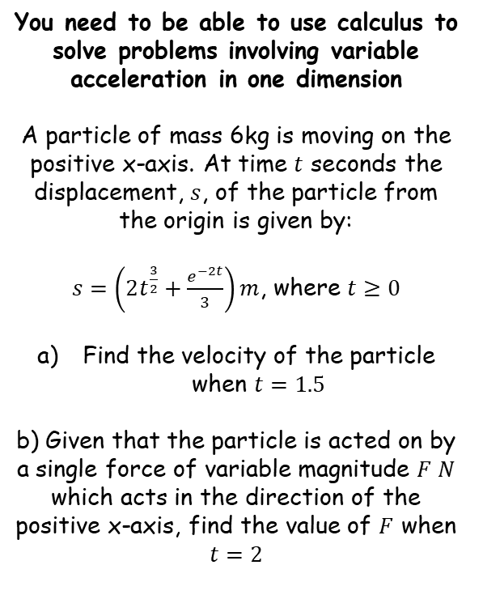




Further Kinematics
You need to be able to use calculus to solve problems involving variable acceleration in one dimension
A particle of mass 6kg is moving on the positive x-axis. At time $t$ seconds the displacement, $s$, of the particle from the origin is given by:
$s=\left(2t^{\frac{3}{2}}+\frac{e^{−2t}}{3}\right)m$, where $t≥0$
Find the velocity of the particle when $t=1.5$
b) Given that the particle is acted on by a single force of variable magnitude $F N$ which acts in the direction of the positive x-axis, find the value of $F$ when $t=2$
Differentiate the formula for the displacement to give a formula for the velocity
$$s=2t^{\frac{3}{2}}+\frac{e^{−2t}}{3}$$
Sometimes writing terms with a fraction at the front helps!
$$s=2t^{\frac{3}{2}}+\frac{1}{3}e^{−2t}$$
Differentiate each term using rules you know
$$v=3t^{\frac{1}{2}}−\frac{2}{3}e^{−2t}$$
Sub in $t=1.5$
$$v=3{(1.5)}^{\frac{1}{2}}−\frac{2}{3}e^{−2(1.5)}$$
$$v=3.64 {ms}^{−1}$$
Calculate
$$v=3.64 {ms}^{−1}$$
8C

Slide 28







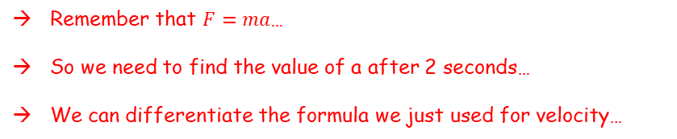


Further Kinematics
Remember that $F=ma$…
So we need to find the value of a after 2 seconds…
We can differentiate the formula we just used for velocity…
You need to be able to use calculus to solve problems involving variable acceleration in one dimension
A particle of mass 6kg is moving on the positive x-axis. At time $t$ seconds the displacement, $s$, of the particle from the origin is given by:
$s=\left(2t^{\frac{3}{2}}+\frac{e^{−2t}}{3}\right)m$, where $t≥0$
Find the velocity of the particle when $t=1.5$
b) Given that the particle is acted on by a single force of variable magnitude $F N$ which acts in the direction of the positive x-axis, find the value of $F$ when $t=2$
$$v=3t^{\frac{1}{2}}−\frac{2}{3}e^{−2t}$$
Differentiate using rules you know
$$a=\frac{3}{2}t^{−\frac{1}{2}}+\frac{4}{3}e^{−2t}$$
Sub in $t=2$
$$a=\frac{3}{2}{(2)}^{−\frac{1}{2}}+\frac{4}{3}e^{−2(2)}$$
Calculate
$$v=3.64 {ms}^{−1}$$
$$a=1.0850…$$
Now we can use this in the formula $F=ma$
$$F=ma$$
Sub in $m$ and $a$
$$F=(6)(1.0850…)$$
Calculate and round
$$F=6.51N$$
8C

Slide 29
Teachings for
Exercise 8D

Slide 30



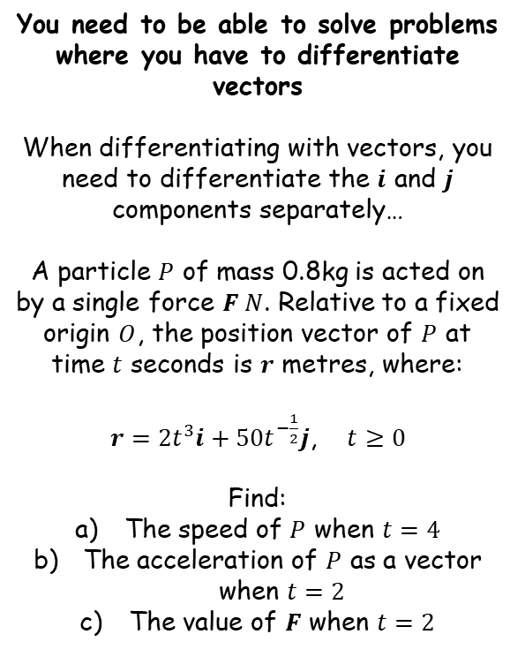






Further Kinematics
You need to be able to solve problems where you have to differentiate vectors
When differentiating with vectors, you need to differentiate the $i$ and $j$ components separately…
A particle $P$ of mass 0.8kg is acted on by a single force $F N$. Relative to a fixed origin $O$, the position vector of $P$ at time $t$ seconds is $r$ metres, where:
$r={2t}^{3}i+50t^{−\frac{1}{2}}j$, $t≥0$
Find:
The speed of $P$ when $t=4$
The acceleration of $P$ as a vector when $t=2$
The value of $F$ when $t=2$
→ Differentiate the position vector to find the velocity vector
$$r={2t}^{3}i+50t^{−\frac{1}{2}}j$$
Differentiate the $i$ and $j$ components separately
$$v={6t}^{2}i−25t^{−\frac{3}{2}}j$$
Sub in $t=4$
$$v={6(4)}^{2}i−25{(4)}^{−\frac{3}{2}}j$$
Calculate
$$v=96i−3.125j$$
Use Pythagoras’ Theorem to find the speed
$$Speed=\sqrt{{\left(96\right)}^{2}+{\left(−3.125\right)}^{2}}$$
Calculate
$$=96.1 {ms}^{−1}$$
$=96.1 {ms}^{−1}$ (3sf)
8D

Slide 31







Further Kinematics
You need to be able to solve problems where you have to differentiate vectors
When differentiating with vectors, you need to differentiate the $i$ and $j$ components separately…
A particle $P$ of mass 0.8kg is acted on by a single force $F N$. Relative to a fixed origin $O$, the position vector of $P$ at time $t$ seconds is $r$ metres, where:
$r={2t}^{3}i+50t^{−\frac{1}{2}}j$, $t≥0$
Find:
The speed of $P$ when $t=4$
The acceleration of $P$ as a vector when $t=2$
The value of $F$ when $t=2$
$$r={2t}^{3}i+50t^{−\frac{1}{2}}j$$
$$v={6t}^{2}i−25t^{−\frac{3}{2}}j$$
→ Differentiate the velocity vector to find the acceleration vector
$$v={6t}^{2}i−25t^{−\frac{3}{2}}j$$
Differentiate the $i$ and $j$ components separately
$$a=12ti+37.5t^{−\frac{5}{2}}j$$
Sub in $t=2$
$$a=12(2)i+37.5{(2)}^{−\frac{5}{2}}j$$
$$a=24i+\frac{75\sqrt{2}}{16}j$$
Calculate and simplify
$$=96.1 {ms}^{−1}$$
$$a=24i+\frac{75\sqrt{2}}{16}j$$
8D

Slide 32





Further Kinematics
You need to be able to solve problems where you have to differentiate vectors
When differentiating with vectors, you need to differentiate the $i$ and $j$ components separately…
A particle $P$ of mass 0.8kg is acted on by a single force $F N$. Relative to a fixed origin $O$, the position vector of $P$ at time $t$ seconds is $r$ metres, where:
$r={2t}^{3}i+50t^{−\frac{1}{2}}j$, $t≥0$
Find:
The speed of $P$ when $t=4$
The acceleration of $P$ as a vector when $t=2$
The value of $F$ when $t=2$
$$r={2t}^{3}i+50t^{−\frac{1}{2}}j$$
$$v={6t}^{2}i−25t^{−\frac{3}{2}}j$$
$$a=24i+\frac{75\sqrt{2}}{16}j$$
→ Use $F=ma$ to find the force as a vector
$$F=ma$$
$$F=(0.8)\left(24i+\frac{75\sqrt{2}}{16}j\right)$$
Sub in values
$$F=\left(19.2i+\frac{15\sqrt{2}}{4}j\right) N$$
Calculate
$$=96.1 {ms}^{−1}$$
$$a=24i+\frac{75\sqrt{2}}{16}j$$
8D

Slide 33
Teachings for
Exercise 8E

Slide 34
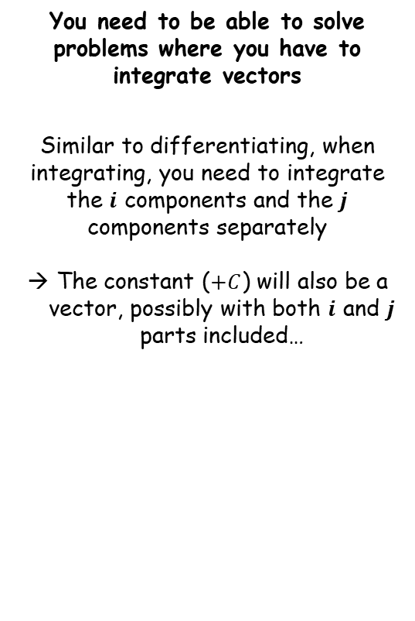
Further Kinematics
You need to be able to solve problems where you have to integrate vectors
Similar to differentiating, when integrating, you need to integrate the $i$ components and the $j$ components separately
The constant ($+C$) will also be a vector, possibly with both $i$ and $j$ parts included…
8E

Slide 35


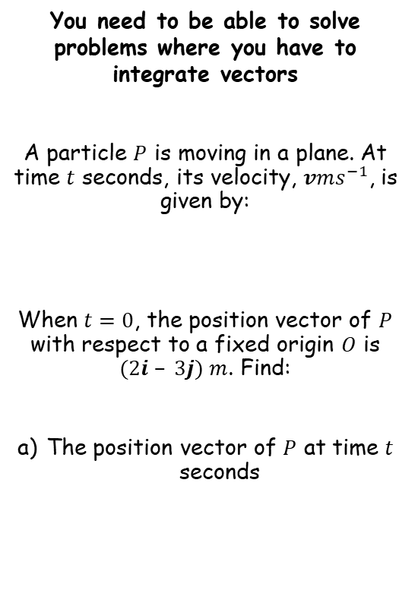

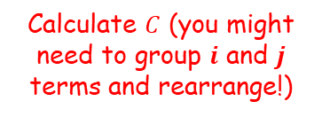
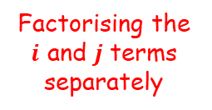







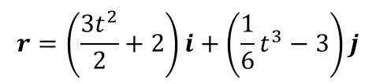
Further Kinematics
→ We need to integrate the velocity to find the position vector
You need to be able to solve problems where you have to integrate vectors
A particle $P$ is moving in a plane. At time $t$ seconds, its velocity, $vms^{−1}$, is given by:
When $t=0$, the position vector of $P$ with respect to a fixed origin $O$ is $(2i – 3j) m$. Find:
The position vector of $P$ at time $t$ seconds
$$v=3ti+\frac{1}{2}t^{2}j$$
Integrate each term, remember to include $C$
$$r=\frac{3t^{2}}{2}i+\frac{1}{6}t^{3}j+C$$
At $t=0$, the position vector $r=(2i – 3j)$
$$(2i−3j)=\frac{3{(0)}^{2}}{2}i+\frac{1}{6}{(0)}^{3}j+C$$
$$v=3ti+\frac{1}{2}t^{2}j$$
Calculate $C$ (you might need to group $i$ and $j$ terms and rearrange!)
$$(2i−3j)=C$$
$$r=\frac{3t^{2}}{2}i+\frac{1}{6}t^{3}j+2i−3j$$
Putting the $i$ and $j$ terms together
$$r=\frac{3t^{2}}{2}i+2i+\frac{1}{6}t^{3}j−3j$$
Factorising the $i$ and $j$ terms separately
$$r=\left(\frac{3t^{2}}{2}+2\right)i+\left(\frac{1}{6}t^{3}−3\right)j$$
8E

Slide 36



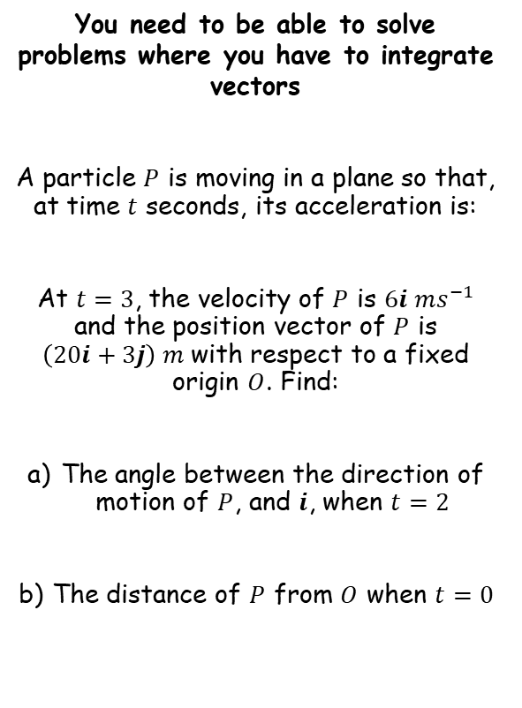












Further Kinematics
→ We need to integrate the acceleration to find the velocity, since this will be the direction of motion
You need to be able to solve problems where you have to integrate vectors
A particle $P$ is moving in a plane so that, at time $t$ seconds, its acceleration is:
At $t=3$, the velocity of $P$ is $6i ms^{−1}$ and the position vector of $P$ is $\left(20i+3j\right) m$with respect to a fixed origin $O$. Find:
The angle between the direction of motion of $P$, and $i$, when $t=2$
The distance of $P$ from $O$ when $t=0$
$$a=4i−2tj$$
Integrate to get $v$, include $C$
$$v=4ti−t^{2}j+C$$
At $t=3$, we know the velocity is $6i$
$$6i=4(3)i−{(3)}^{2}j+C$$
$$a=\left(4i−2tj\right)ms^{−2}$$
Calculate terms
$$6i=12i−9j+C$$
Rearrange to get the missing vector $C$
$$−6i+9j=C$$
$$v=4ti−t^{2}j−6i+9j$$
Group $i$ and $j$ terms and factorise
$$v=\left(4t−6\right)i+(−t^{2}+9)j$$
Sub in $t=2$ to find the velocity vector
$$v=\left(4(2)−6\right)i+(−{(2)}^{2}+9)j$$
$$v=2i+5j$$
Calculate terms
8E

Slide 37








Further Kinematics
You need to be able to solve problems where you have to integrate vectors
A particle $P$ is moving in a plane so that, at time $t$ seconds, its acceleration is:
At $t=3$, the velocity of $P$ is $6i ms^{−1}$ and the position vector of $P$ is $\left(20i+3j\right) m$with respect to a fixed origin $O$. Find:
The angle between the direction of motion of $P$, and $i$, when $t=2$
The distance of $P$ from $O$ when $t=0$
$$v=2i+5j$$
$$2i+5j$$
$$5j$$
θ
$$a=\left(4i−2tj\right)ms^{−2}$$
$$2i$$
$$Tanθ=\frac{Opp}{Adj}$$
Sub in opp and adj
$$Tanθ=\frac{5}{2}$$
Inverse Tan
$$θ=Tan^{−1}\left(\frac{5}{2}\right)$$
This angle is the one we want
→ It is between the direction of motion and the direction I (horizontal)
$$θ=68.2°$$
8E

Slide 38







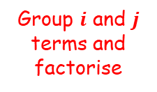




Further Kinematics
$$a=4i−2tj$$
$$v=\left(4t−6\right)i+(−t^{2}+9)j$$
You need to be able to solve problems where you have to integrate vectors
A particle $P$ is moving in a plane so that, at time $t$ seconds, its acceleration is:
At $t=3$, the velocity of $P$ is $6i ms^{−1}$ and the position vector of $P$ is $\left(20i+3j\right) m$with respect to a fixed origin $O$. Find:
The angle between the direction of motion of $P$, and $i$, when $t=2$
The distance of $P$ from $O$ when $t=0$
→ We need to integrate the velocity vector to find the position vector
$$v=\left(4t−6\right)i+(−t^{2}+9)j$$
Integrate to get $r$, include $D$
$$r=\left(2t^{2}−6t\right)i+\left(−\frac{t^{3}}{3}+9t\right)j+D$$
$$a=\left(4i−2tj\right)ms^{−2}$$
Sub in values we are told
$$(20i+3j)=\left(2{(3)}^{2}−6(3)\right)i+\left(−\frac{{\left(3\right)}^{3}}{3}+9(3)\right)j+D$$
Calculate terms
$$(20i+3j)=18j+D$$
Rearrange to find $D$
$$(20i−15j)=D$$
θ = 68.2°
$$r=\left(2t^{2}−6t\right)i+\left(−\frac{t^{3}}{3}+9t\right)j+20i−15j$$
Group $i$ and $j$ terms and factorise
$$r=\left(2t^{2}−6t+20\right)i+\left(−\frac{t^{3}}{3}+9t−15\right)j$$
8E

Slide 39







Further Kinematics
$$a=4i−2tj$$
$$v=\left(4t−6\right)i+(−t^{2}+9)j$$
You need to be able to solve problems where you have to integrate vectors
A particle $P$ is moving in a plane so that, at time $t$ seconds, its acceleration is:
At $t=3$, the velocity of $P$ is $6i ms^{−1}$ and the position vector of $P$ is $\left(20i+3j\right) m$with respect to a fixed origin $O$. Find:
The angle between the direction of motion of $P$, and $i$, when $t=2$
The distance of $P$ from $O$ when $t=0$
$$r=\left(2t^{2}−6t+20\right)i+\left(−\frac{t^{3}}{3}+9t−15\right)j$$
→ Now we can use the value of $t$
$$r=\left(2t^{2}−6t+20\right)i+\left(−\frac{t^{3}}{3}+9t−15\right)j$$
$$a=\left(4i−2tj\right)ms^{−2}$$
Sub in $t=0$
$$r=\left(2{(0)}^{2}−6(0)+20\right)i+\left(−\frac{{\left(0\right)}^{3}}{3}+9(0)−15\right)j$$
Calculate $r$
$$r=20i−15j$$
θ = 68.2°
→ Remember that this is not the distance…
8E

Slide 40







Further Kinematics
$$a=4i−2tj$$
$$v=\left(4t−6\right)i+(−t^{2}+9)j$$
You need to be able to solve problems where you have to integrate vectors
A particle $P$ is moving in a plane so that, at time $t$ seconds, its acceleration is:
At $t=3$, the velocity of $P$ is $6i ms^{−1}$ and the position vector of $P$ is $\left(20i+3j\right) m$with respect to a fixed origin $O$. Find:
The angle between the direction of motion of $P$, and $i$, when $t=2$
The distance of $P$ from $O$ when $t=0$
$$r=\left(2t^{2}−6t+20\right)i+\left(−\frac{t^{3}}{3}+9t−15\right)j$$
$$r=20i−15j$$
$$a=\left(4i−2tj\right)ms^{−2}$$
$$20i$$
$$−15j$$
$$20i−15j$$
Use Pythagoras’ Theorem to calculate the actual distance – the vector just represents the displacement
θ = 68.2°
$$\sqrt{{(20)}^{2}+{(−15)}^{2}}$$
$$25m$$
$$=25m$$
8E

Slide 41


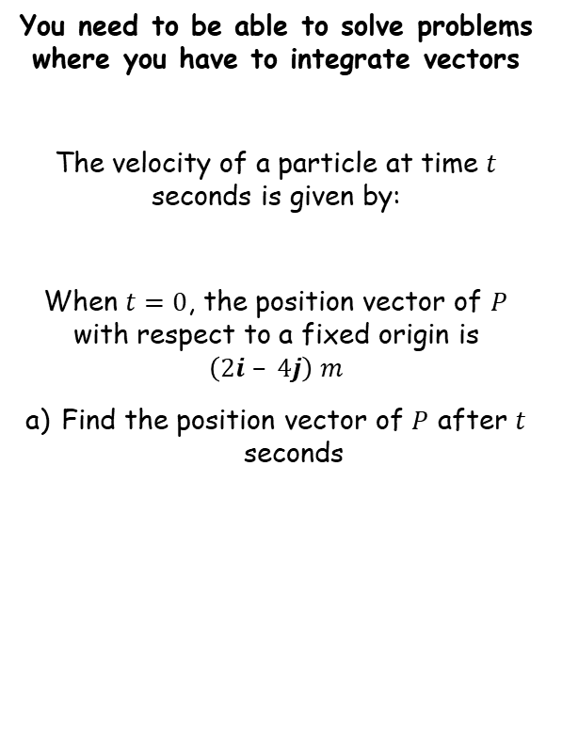











Further Kinematics
You need to be able to solve problems where you have to integrate vectors
The velocity of a particle at time $t$ seconds is given by:
When $t=0$, the position vector of $P$ with respect to a fixed origin is $\left(2i – 4j\right) m$
Find the position vector of $P$ after $t$ seconds
$$v=\left(3t^{2}−8\right)i+5j$$
Integrate to find $r$, include $C$
$$r=\left(t^{3}−8t\right)i+5tj+C$$
Sub in the values given
$$2i−4j=\left({(0)}^{3}−8(0)\right)i+5(0)j+C$$
$$v=\left(3t^{2}−8\right)i+5j$$
Find $C$
$$2i−4j=C$$
$$r=\left(t^{3}−8t\right)i+5tj+C$$
Sub in the value of $C$ we found
$$r=\left(t^{3}−8t+2\right)i+(5t−4)j$$
$$r=\left(t^{3}−8t\right)i+5tj+2i−4j$$
Group $i$ and $j$ terms and factorise
$$r=\left(t^{3}−8t+2\right)i+(5t−4)j$$
8E

Slide 42


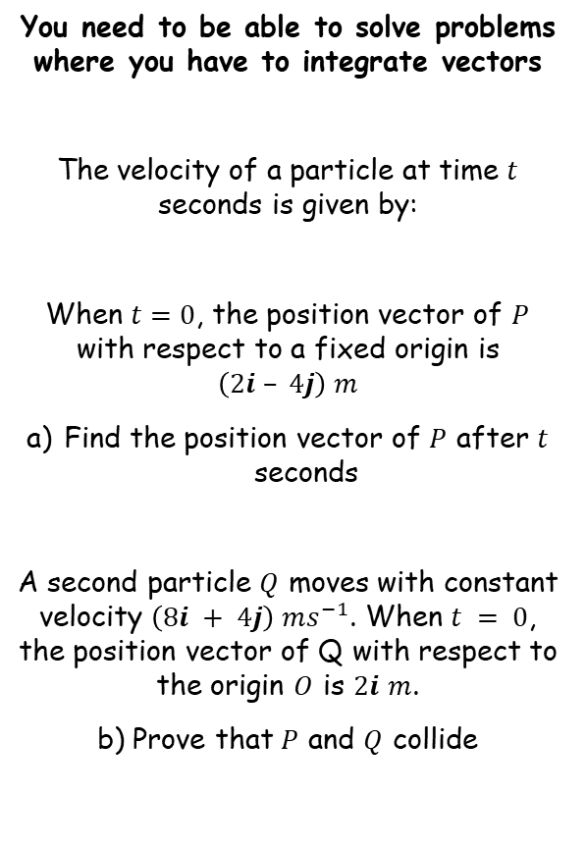







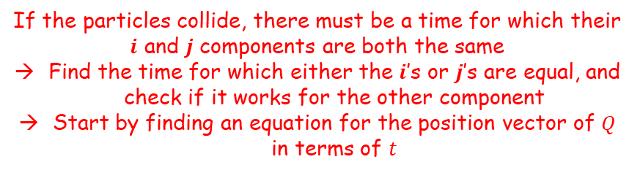


Further Kinematics
You need to be able to solve problems where you have to integrate vectors
The velocity of a particle at time $t$ seconds is given by:
When $t=0$, the position vector of $P$ with respect to a fixed origin is $\left(2i – 4j\right) m$
Find the position vector of $P$ after $t$ seconds
A second particle $Q$ moves with constant velocity $\left(8i + 4j\right) ms^{−1}$. When $t = 0$, the position vector of Q with respect to the origin $O$ is $2i$ $m$.
b) Prove that $P$ and $Q$ collide
If the particles collide, there must be a time for which their $i$ and $j$ components are both the same
Find the time for which either the $i$’s or $j$’s are equal, and check if it works for the other component
Start by finding an equation for the position vector of $Q$ in terms of $t$
$$v=\left(3t^{2}−8\right)i+5j$$
$$v=8i+4j$$
Integrate to find $r$, include $D$
$$r=8ti+4tj+D$$
Sub in the values given
$$2i=8(0)i+4(0)j+D$$
Find $D$
$$2i=D$$
$$r=\left(t^{3}−8t+2\right)i+(5t−4)j$$
$$r=8ti+4tj+D$$
Sub in the value of $D$ we have
$$r=8ti+4tj+2i$$
Group $i$ and $j$ terms and factorise
$$r=(8t+2)i+4tj$$
$$r=(8t+2)i+4tj$$
8E

Slide 43









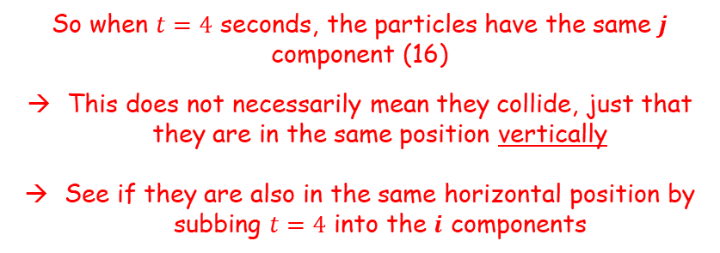




Further Kinematics
For $Q$
For $P$
You need to be able to solve problems where you have to integrate vectors
The velocity of a particle at time $t$ seconds is given by:
When $t=0$, the position vector of $P$ with respect to a fixed origin is $\left(2i – 4j\right) m$
Find the position vector of $P$ after $t$ seconds
A second particle $Q$ moves with constant velocity $\left(8i + 4j\right) ms^{−1}$. When $t = 0$, the position vector of Q with respect to the origin $O$ is $2i$ $m$.
b) Prove that $P$ and $Q$ collide
$$r=(8t+2)i+4tj$$
$$r=\left(t^{3}−8t+2\right)i+(5t−4)j$$
Find the value of $t$ for which the $j$ terms are equal (this is easier than comparing the $i$ terms!)
$$4t=5t−4$$
Solve for $t$
$$v=\left(3t^{2}−8\right)i+5j$$
$$t=4$$
So when $t=4$ seconds, the particles have the same $j$ component (16)
This does not necessarily mean they collide, just that they are in the same position vertically
See if they are also in the same horizontal position by subbing $t=4$ into the $i$ components
$$r=\left(t^{3}−8t+2\right)i+(5t−4)j$$
For Q
For P
$$8t+2$$
$$t^{3}−8t+2$$
$$8(4)+2$$
$${(4)}^{3}− 8(4)+2$$
$$=34$$
$$=34$$
$$r=(8t+2)i+4tj$$
So the particles collide after 4 seconds at position $(34i + 16j) m$
8E

